Slide 1

SOLAR PANNEL DAMAGE DETECTIN

Slide 2
Project Submitted
Name: Abhijeet Panda
https://www.linkedin.com/in/imabhijeetpanda

Slide 3

Contents
Business objective
Business Constraints
Project Architecture
Data collection and details
Exploratory Data Analysis
Visualization
Modeling
Evaluation
Deployment
Notes:
Change

Slide 4
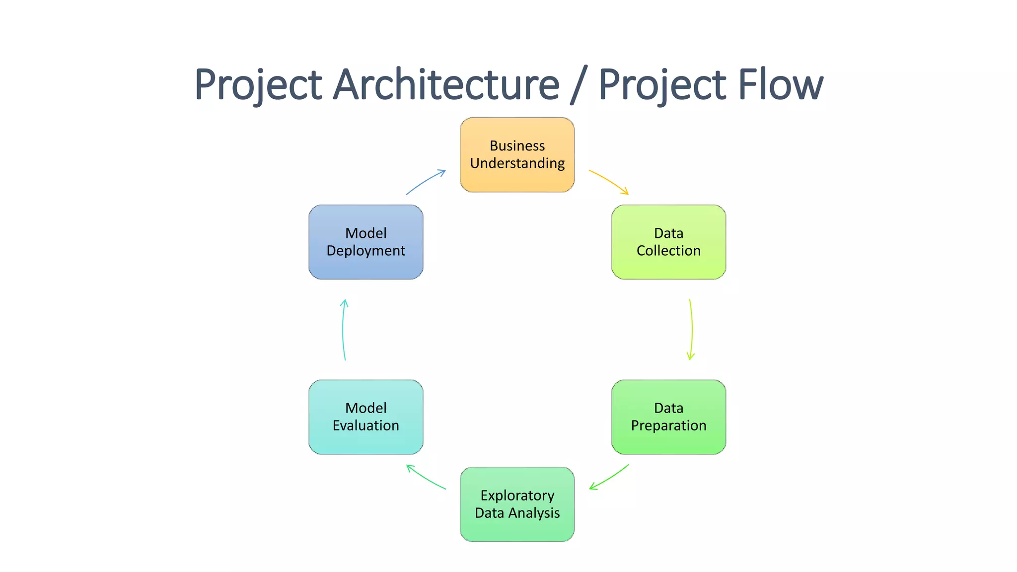
Project Overview and Scope

Slide 5
Business Problem
High Maintenance Costs: The company is facing higher-than-desired maintenance costs due to the inefficiencies in identifying and addressing faults in the solar modules.
Need for Enhanced Monitoring: To maximize uptime and reliability, the company requires more advanced monitoring solutions that can proactively detect and address issues in their large PV system portfolio.
Resource Optimization: There is a critical need to optimize the use of resources, including manpower and equipment, to maintain the PV systems more effectively without incurring additional costs.

Slide 6
Business Objective
Objective
Constraints
Minimized Maintenance Costs: Ensure the solution is cost-effective, reducing overall maintenance expenses.
Resource Efficiency: Optimize the use of resources such as manpower and time, ensuring the solution is both effective and sustainable.
Scalability and Integration: The solution must be scalable and seamlessly integrate with existing systems, supporting a large PV portfolio without significant disruptions.
Data Quality and Compliance: Rely on high-quality data and adhere to industry standards, ensuring accuracy while maintaining regulatory compliance.
Maximize solar PV system uptime.

Slide 7
CRISP-ML(Q) Methodology
There are six stages of CRISP-ML(Q) Methodology
1.Business and data understanding
2.Data preparation
3.model building
4.Model evaluation
5.Model deployment
6.Monitoring and maintenance

Slide 8
Technical Stacks
Machine Learning & AI:
Python: Core language for model development.
TensorFlow / PyTorch: Deep learning frameworks for fault detection.
Scikit-learn: Traditional ML algorithms and preprocessing.
Computer Vision:
Roboflow: Image annotation and dataset management.
YOLO Models: Object detection for identifying faults in solar panels.
OpenCV: Image processing and analysis.
Cloud & Infrastructure:
AWS / Azure / Google Cloud: Scalable cloud computing.

Slide 9
Data Collection and Understanding
Data Sources:
Kaggle: Acquired datasets containing labeled solar panel images.
Google Search Images: Supplemented with additional images for comprehensive coverage.
Data Characteristics:
Image Categories: Includes clean panels, bird droppings, electrical damage, physical damage, and dusty panels.
Data Cleaning: Removed irrelevant images (e.g., snow drops) to focus on actionable faults.
Annotation: Images annotated using Roboflow for specific fault detection.
Data Preparation:
Preprocessing: Images were resized, augmented, and normalized to enhance model performance.
Dataset Splitting: Divided into training, validation, and test sets for accurate model evaluation.

Slide 10
Data Information
Image Categories:
Clean Panels: Images of well-maintained solar panels with no visible faults.
Bird Droppings: Panels with bird droppings affecting performance.
Electrical Damage: Visible electrical faults on solar panels.
Physical Damage: Panels with cracks, scratches, or other physical impairments.
Dusty Panels: Solar panels covered with dust, impacting efficiency.
Dataset Size:
Total Images: 721
Distribution: Balanced across categories to ensure robust model training.
Data Quality:
High-Resolution Images: Ensuring clarity for accurate annotation and model training.
Manual Annotation: All images were manually annotated using Roboflow to ensure precise fault detection.

Slide 11
System Requirements
Hardware:
Processor: Multi-core CPU
Memory: Minimum 16 GB RAM
Storage: SSD with at least 1 TB of available space
Graphics Card: NVIDIA GPU with CUDA support for deep learning tasks
Software:
Operating System: Windows 10, macOS 12 or later, or a Linux distribution (Ubuntu preferred)
Python: Version 3.8 or later
Machine Learning Libraries: TensorFlow, PyTorch, Scikit-learn
Computer Vision Tools: OpenCV, YOLO models
Data Annotation Tools: Roboflow
Development Environments: Jupyter Notebook, Google Colab, or Spyder IDE
Network:
Internet Connection: Stable high-speed internet for data downloads and cloud access

Slide 12
Exploratory Data Analysis [EDA]
Feature Exploration:
Annotations: Review of bounding box accuracy and coverage.
Resolution Analysis: Distribution of image resolutions.
Correlation Analysis:
Explore any correlations between different features or fault types.
Notes:
EDA is used for seeing what the data can tell us before the modeling task.
Change

Slide 13
Data Preprocessing
Data Cleaning:
Removed irrelevant images (e.g., snow drops).
Image Resizing:
Standardized all images to 640x640 pixels.
Data Augmentation:
Applied rotations, scaling, and flips to enhance dataset diversity.
Normalization:
Scaled pixel values to 0-1 range.
Annotation Validation:
Verified accuracy of bounding boxes and labels.
Dataset Splitting:
Divided into 70% training, 15% validation, and 15% test sets.
Tools Used:
Roboflow, OpenCV, TensorFlow
Notes:
Keep observations

Slide 14
Data Visualization
Bounding Box Review:
Overlay Images: Visualizes annotated bounding boxes to check annotation accuracy.
Tools Used:
Roboflow: For visualizing annotated images.
Notes:
Add graphical

Slide 15
Model Building
Models Used:
YOLOv5: Baseline object detection for initial fault identification.
YOLOv7: Enhanced performance and efficiency.
YOLOv8: Advanced accuracy and features.
Training Setup:
Platform: Google Colab for running models and leveraging GPU resources.
Data: Trained on annotated images with categories such as clean, bird droppings, electrical damage, and physical damage.
Hyperparameters: Optimized for each YOLO version to improve results.
Evaluation:
Metrics: Used mAP (mean Average Precision) to measure accuracy.
Validation: Tested on validation set to ensure effective fault detection.
Tools Used:
Roboflow: Dataset management and integration.
PyTorch: Framework for YOLO models.
Notes:
classification is the task of predicting a discrete class label. Regression is the task of predicting a continuous quantity.
What is classification techniques in machine learning?
The Classification algorithm is a Supervised Learning technique that is used to identify the category of new observations on the basis of training data. In Classification, a program learns from the given dataset or observations and then classifies new observation into several classes or groups.
What is regression techniques in machine learning?
Regression is a technique for investigating the relationship between independent variables or features and a dependent variable or outcome. It's used as a method for predictive modeling in machine learning, in which an algorithm is used to predict continuous outcomes.

Slide 16
Model Accuracy Comparison
YOLOv9:
Epochs: 100
mAP50: 79%
mAP50-95: 63%
Notes: Highest accuracy in both mAP50 and mAP50-95.
YOLOv8:
Epochs: 100
mAP50: 79%
mAP50-95: 59%
Notes: Comparable mAP50 to YOLOv9, slightly lower mAP50-95.
YOLOv5:
Epochs: 100
mAP50: 69%
mAP50-95: 42%
Notes: Lower accuracy compared to YOLOv8 and YOLOv9.

Slide 17
Best Model –
Model: YOLOv9
Epochs: 100
mAP50: 79%
mAP50-95: 63%
Key Strengths:
Highest Accuracy: Best performance in both mAP50 and mAP50-95.
Advanced Features: Latest enhancements for superior detection.
Reason for Selection:
Performance: Consistently higher accuracy compared to YOLOv5 and YOLOv8.
Efficiency: Balanced performance across various IoU thresholds, making it ideal for reliable fault detection.
Notes:
Why Random Forest Regression is good?
A Random Forest Regression model is powerful and accurate. It usually performs great on many problems, including features with non-linear relationships
How is XGBoost different from random forest?
One of the most important differences between XG Boost and Random forest is that the XGBoost always gives more importance to functional space when reducing the cost of a model while Random Forest tries to give more preferences to hyperparameters to optimize the model..
n_estimators — the number of decision trees you will be running in the model

Slide 18
Model Deployment - Strategy
Deployment Platform:
Streamlit: Used for creating an interactive web application for model deployment.
Implementation Steps:
Model Integration: Integrated YOLOv9 model into the Streamlit app.
User Interface: Developed a user-friendly interface for uploading images and viewing predictions.
Real-Time Inference: Enabled real-time fault detection and visualization of results.
Features:
Image Upload: Users can upload images for analysis.
Fault Detection: Displays detected faults with bounding boxes.
Performance Metrics: Provides feedback on detection accuracy and model performance.
Tools Used:
Streamlit: For building and deploying the web application.
Python: For backend processing and integration with YOLOv9.

Slide 19
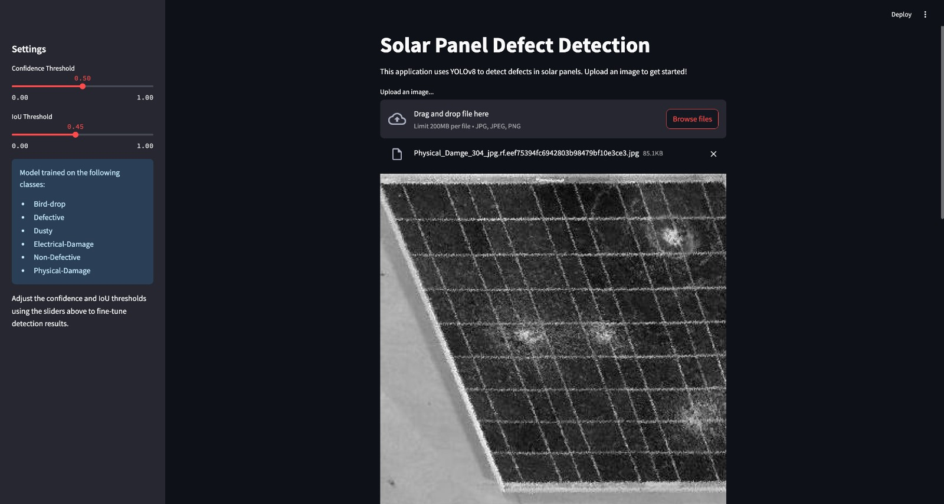
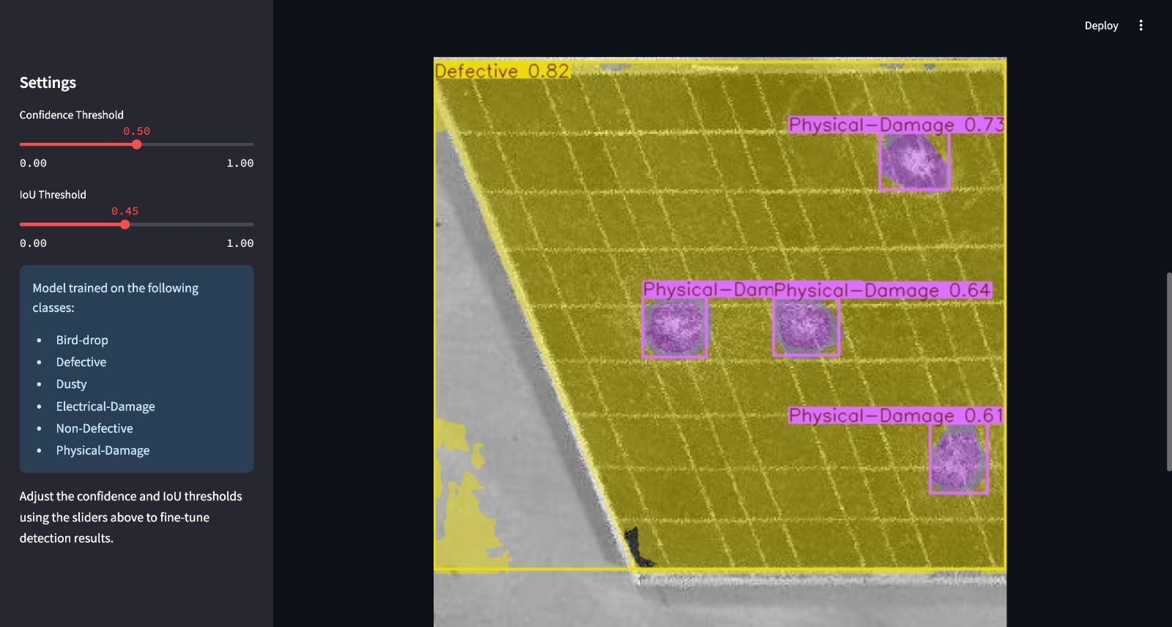
Screen shot of output
Output Image
Input Image

Slide 20
Challenges
Data Quality:
Annotation Accuracy: Ensuring precise labeling and bounding box placement.
Image Variability: Handling diverse image conditions and resolutions.
Model Performance:
Accuracy vs. Speed: Balancing model accuracy with inference speed.
Overfitting: Preventing overfitting to the training data while maintaining generalization.
Deployment:
Real-Time Processing: Managing latency and ensuring smooth real-time predictions.
Resource Management: Optimizing resource usage for deployment on Streamlit.
Scalability:
Handling Large Volumes: Ensuring the solution can scale with increasing data and user load.
Maintenance: Regular updates and model retraining to maintain accuracy over time.

Slide 21
Future Scopes
Model Enhancement:
Exploration of New Models: Evaluate emerging models and techniques for improved accuracy and efficiency.
Transfer Learning: Apply transfer learning to adapt models to new fault types or environments.
Advanced Features:
Automated Fault Diagnosis: Implement automated classification and diagnosis based on detected faults.
Predictive Maintenance: Integrate predictive analytics to forecast and prevent potential faults before they occur.
Scalability:
Cloud Deployment: Transition to cloud-based solutions for better scalability and resource management.
Integration with IoT: Utilize IoT sensors for real-time monitoring and automated fault detection.
User Experience:
Enhanced UI/UX: Improve user interface and experience for easier interaction and more detailed feedback.
Mobile Application: Develop a mobile app for on-the-go access to fault detection features.
Data Expansion:
Broaden Dataset: Incorporate more diverse and extensive datasets to cover additional fault types and scenarios.

Slide 22


